Slide 1
BW/4HANA – Reporting FAQ

Slide 2
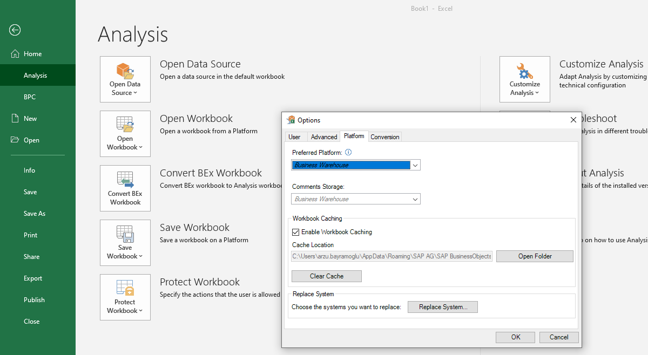
How to choose Business Warehouse Platform
Execute Analysis for Microsoft Excel, go to File -> Analysis - > Customize Analysis -> Options -> Platform : Select Business Warehouse. This is a one-time activity.

Slide 3
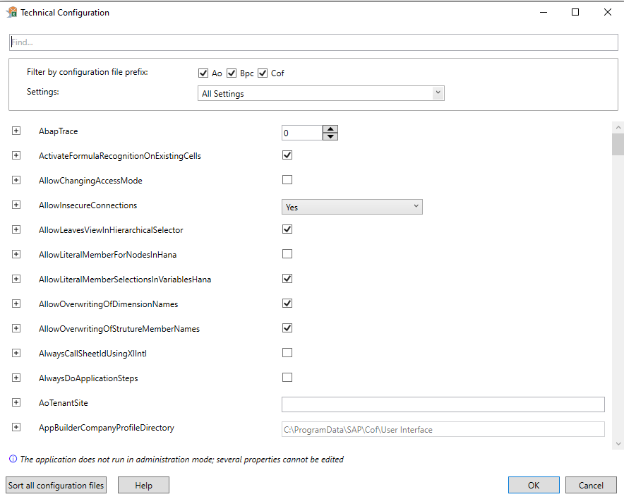
How to avoid Insecure Connection Error
File -> Analysis - > Customize Analysis ->Technical Configuration : Select «AllowInsecureConnections» as Yes. This is a one-time activity.

Slide 4
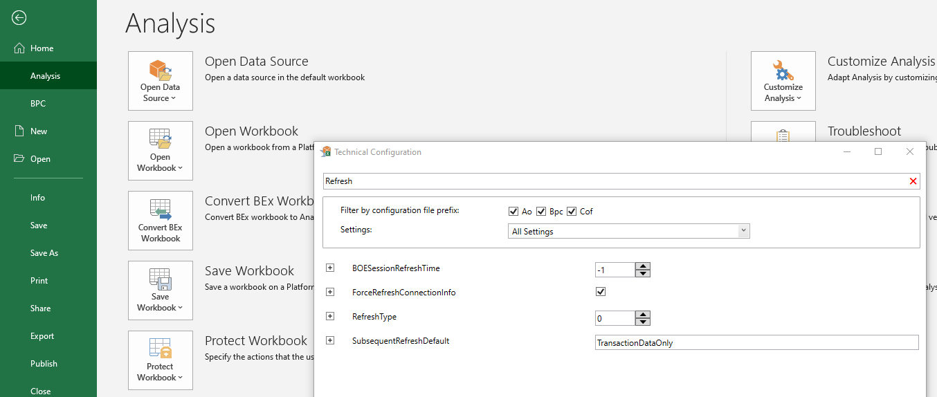
How to remove «Try with/without SNC» Alert
File -> Analysis - > Customize Analysis ->Technical Configuration : Type «Refresh» on the search box -> Tick «ForceRefreshConnectionInfo»

Slide 5
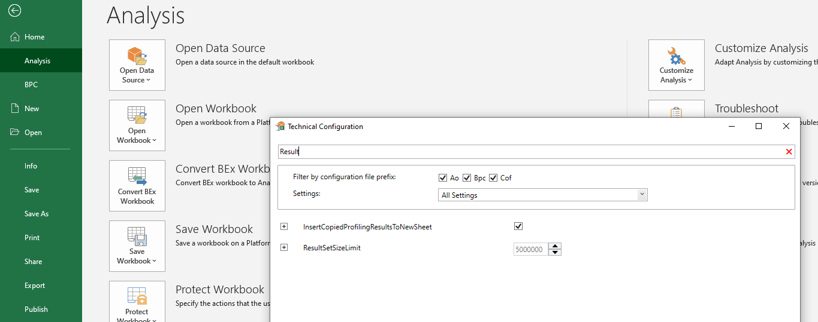
How to overcome «Size Limit Exceeded» Error
File -> Analysis - > Customize Analysis ->Technical Configuration -> Type «Result» on the search box -> Set ResultSetSizeLimit as max. 5.000.000

Slide 6
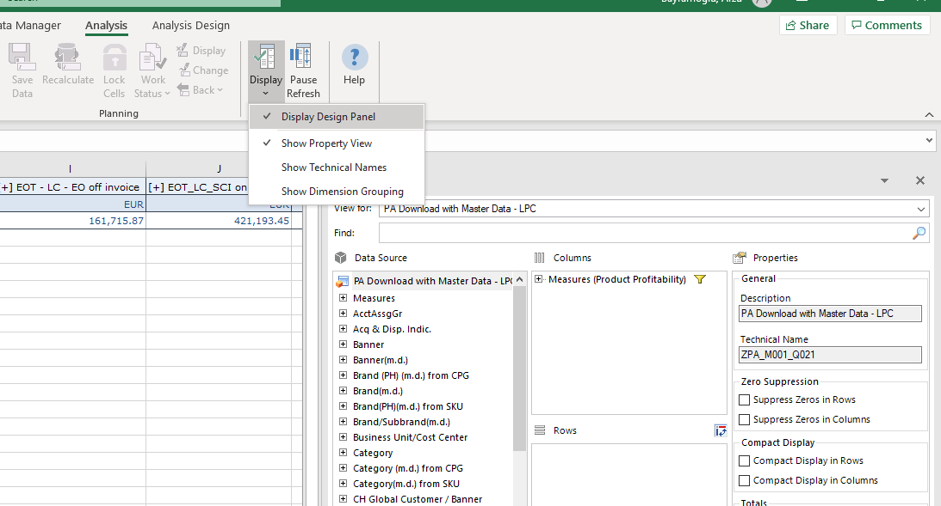
How to enable Property View
Analysis -> Display -> Select «Display Design Panel» and «Show Property View»

Slide 7
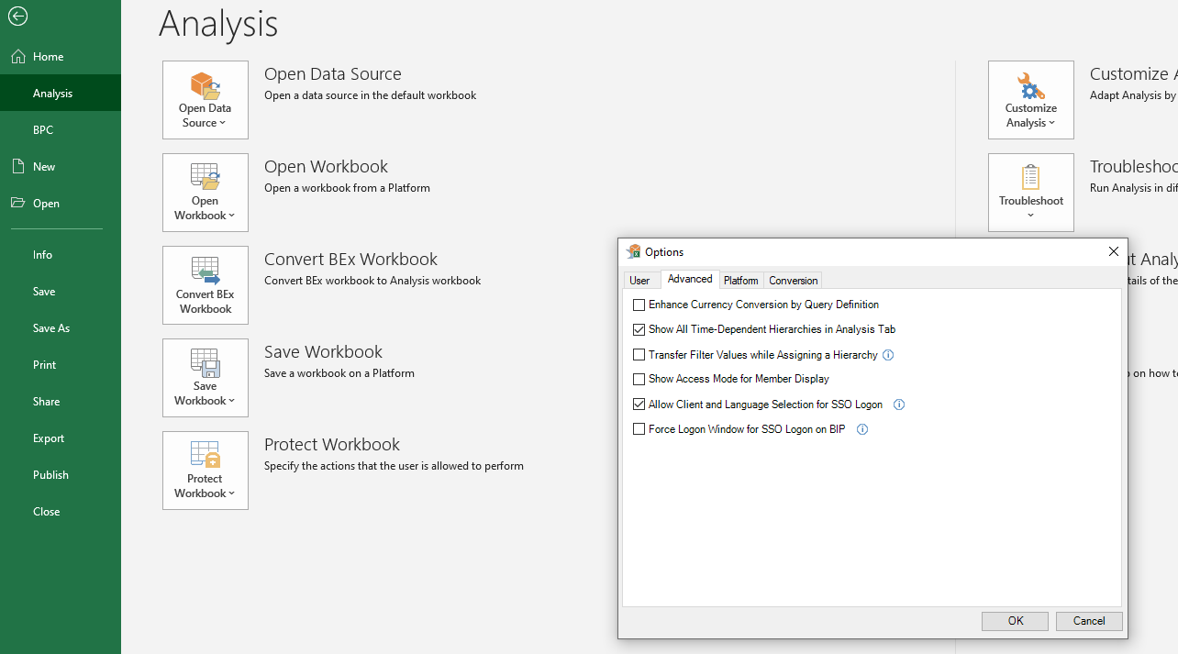
How to enable Login with different Language
File -> Analysis - > Customize Analysis -> Options -> Advanced -> Tick «Allow Client and Language Selection for SSO Logon»

Slide 8
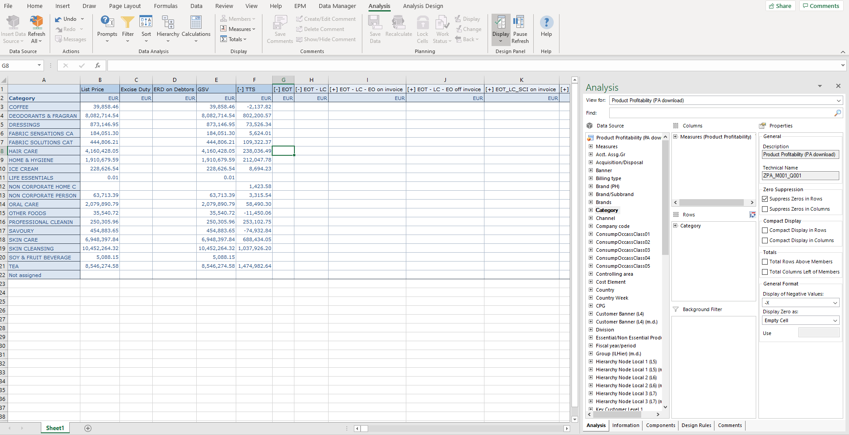
AFO Layout
Variant update, filtering, sorting etc
can be done from this menu
Filtering, drilldowns can be
done via drag drop
Output modifications such as
zero suppression can be
done via here

Slide 9
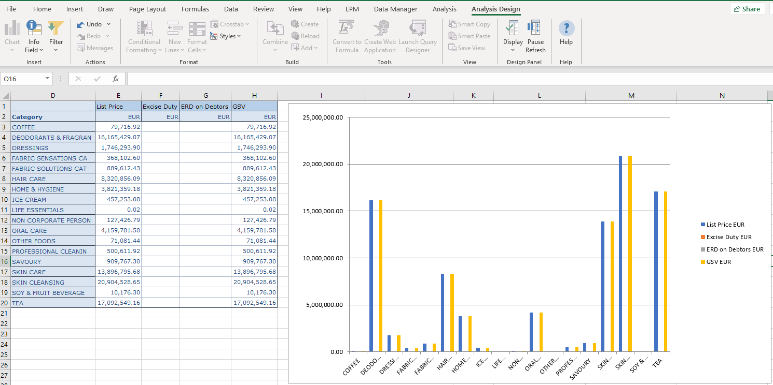
Smart Copy & Paste
Under Analysis Design tab – Smart Copy & Smart Paste,
output can be converted to a chart

Slide 10
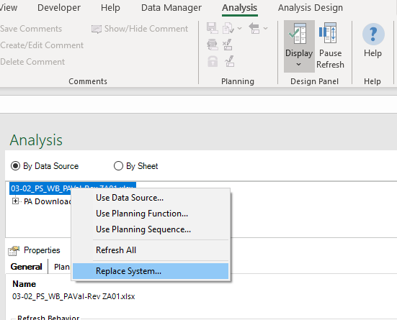
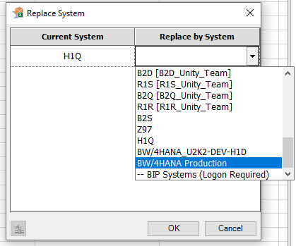
Local Workbook System Connection Update

Slide 11
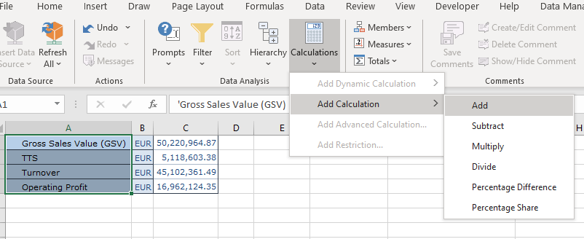
How to create Local Formula - 1
Select all the measures you want to add local formula for -> Calculations -> Add Calculation

Slide 12
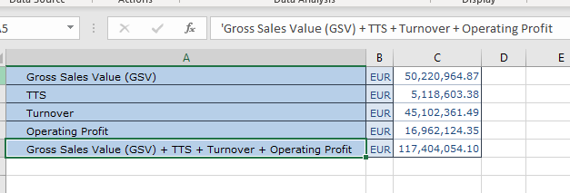
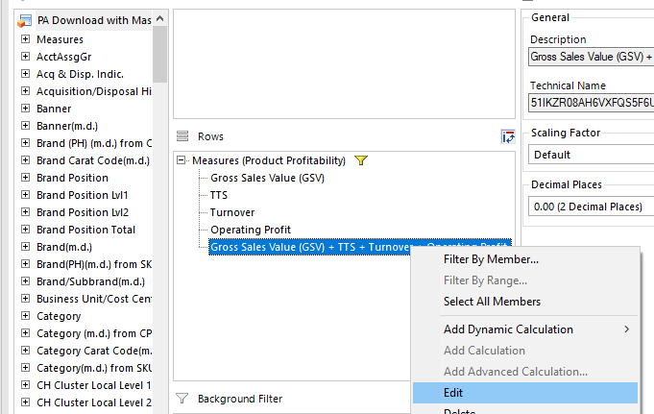
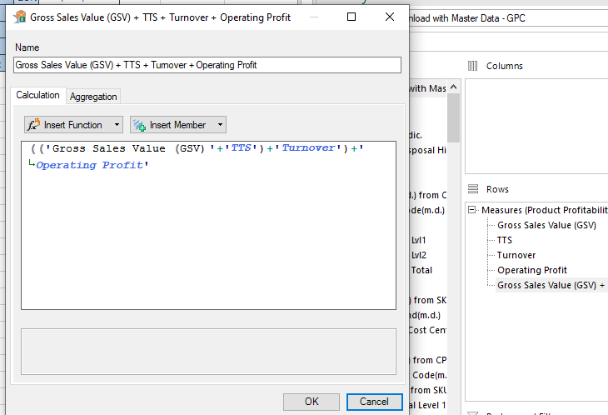
How to create Local Formula - 2
Local formula result is added at the end
Change the description or the calculation logic as following:

Slide 13
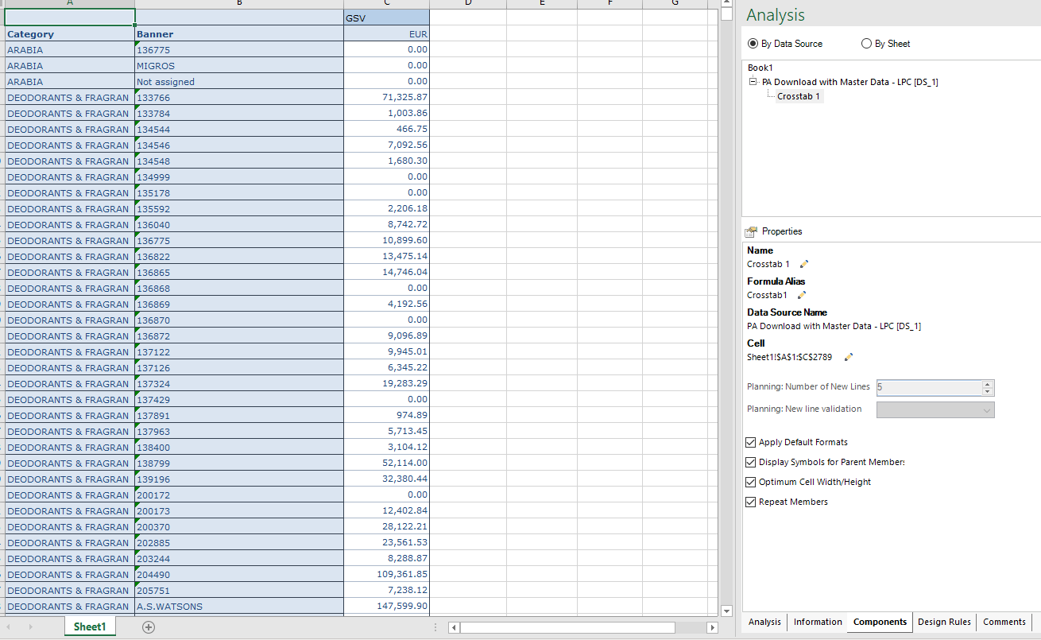
How to repeat values

Slide 14
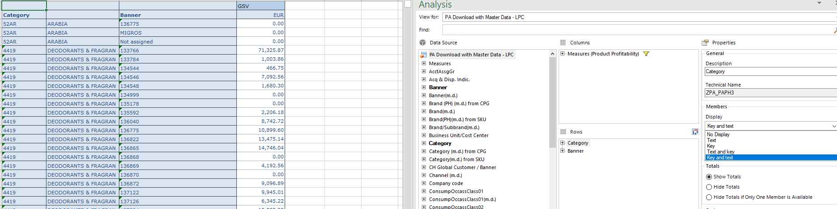
How to display key & text

Slide 15
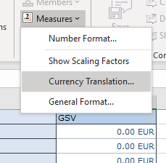
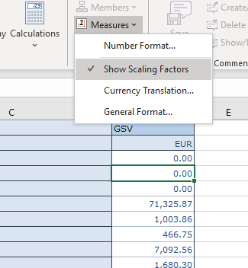
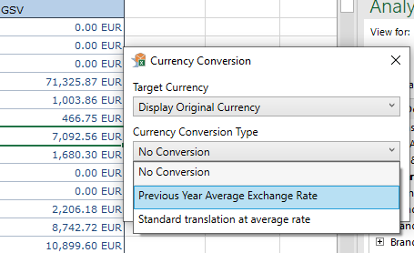
How to enable Scaling & Currency Translation

Slide 16
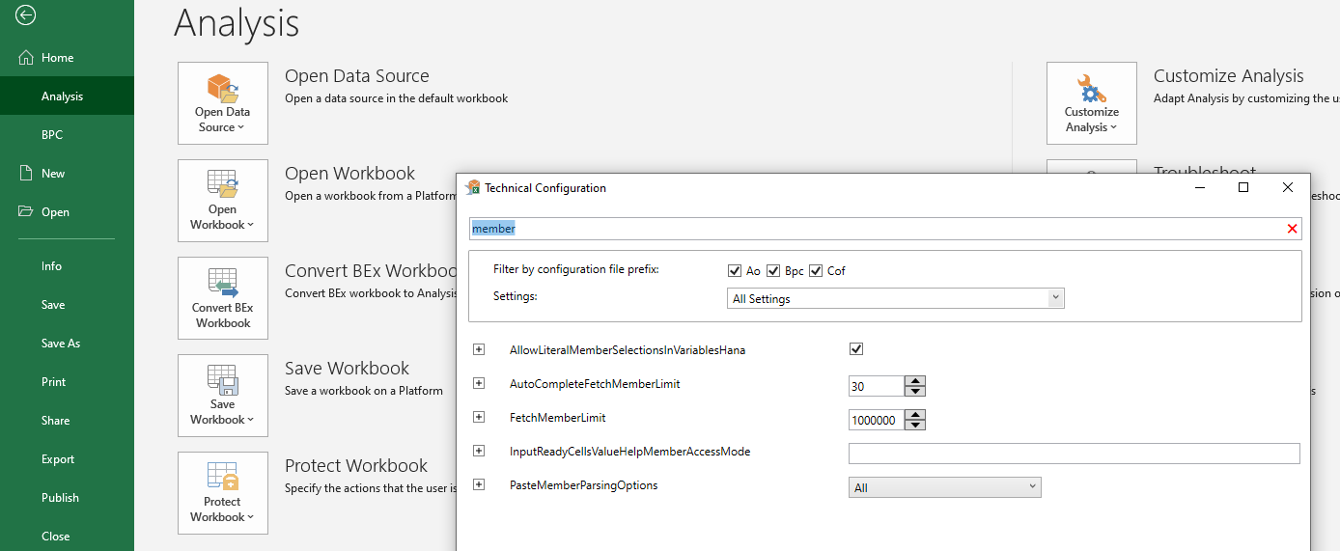
How to increase Member Display Limit for filtering
File -> Analysis - > Customize Analysis ->Technical Configuration -> Type «member» on the search box -> Set FetchMemberLimit as max. 1.000.000

Slide 17
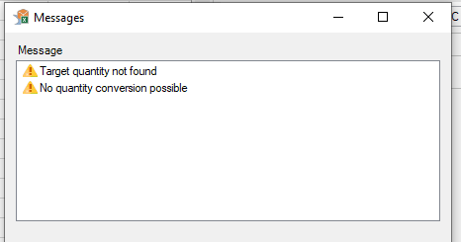
Target Quantity not found warning
Below warning comes up if the query has Quantity measure on the output; in case there is an SKU with postings having multiple Units, this warning comes up; it’s not an error but a «warning».

Slide 18
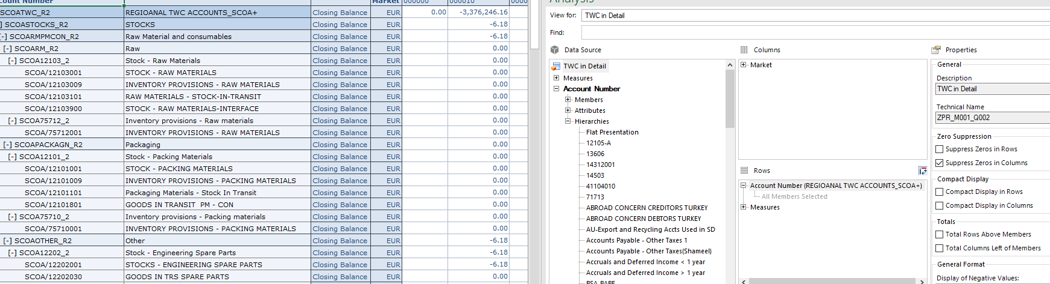
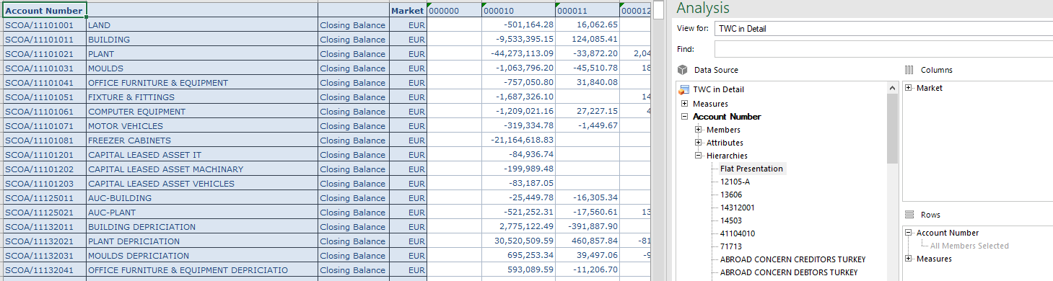
Deactivating Hierarchies – Flat Presentation
Find the object with hierarchy display, under hierarchies double click on «Flat Presentation»

